Slide 1

Gain and Phase Analyzer
Interim Report
2014, December 5th

Slide 2
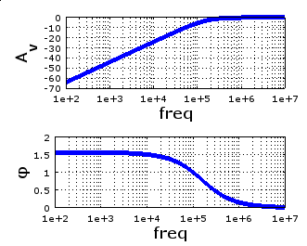
Purpose
Test the frequency behavior of filters, amplifiers
Generate Bode plot with
amplitude and phase

Slide 3
Gain and Phase Analyzer
Requirements
Design
Prototyping
Schedule
Budget
Next Steps

Slide 4
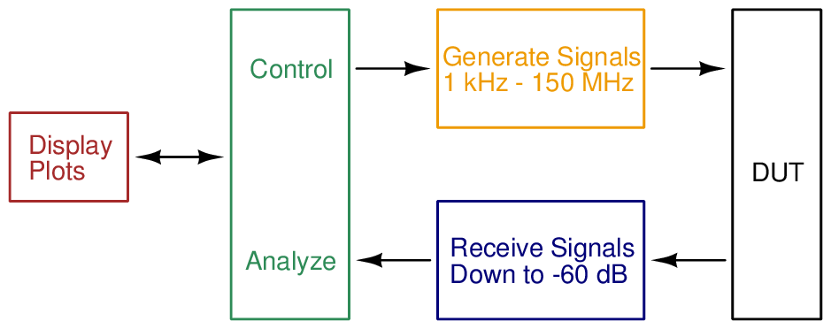
Requirements

Slide 5
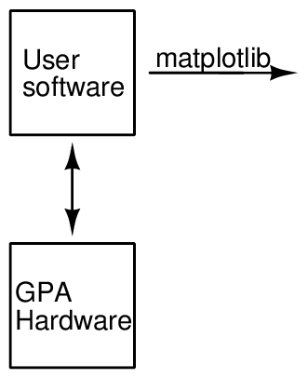
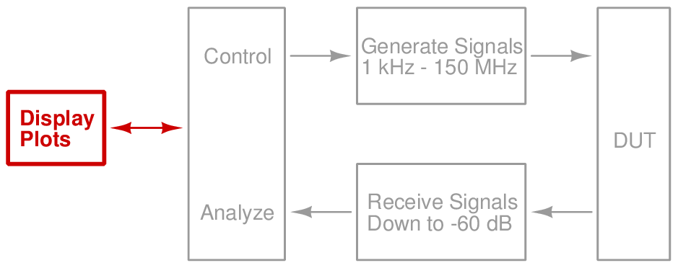
Design — Software

Slide 6
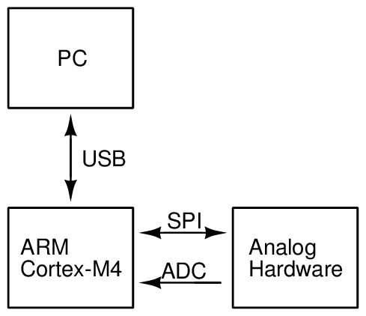
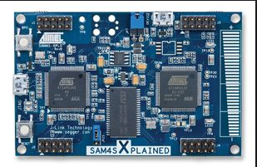
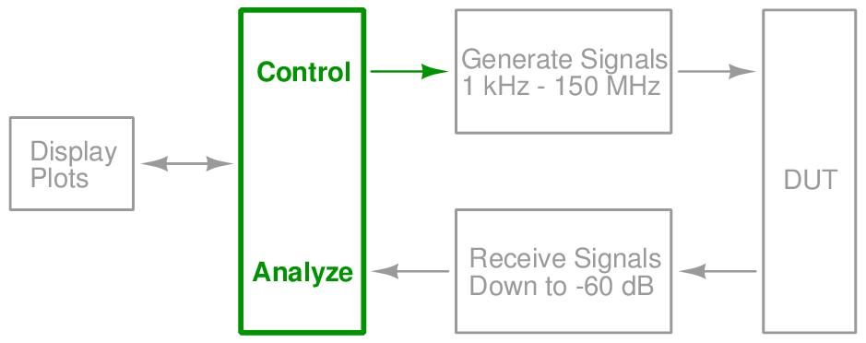
Design — Microcontroller

Slide 7
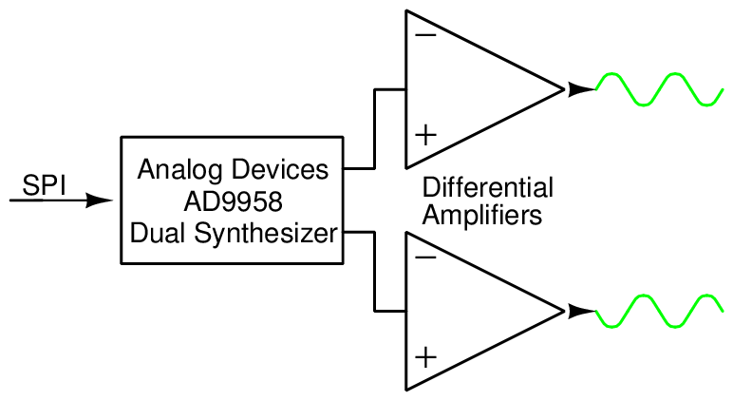
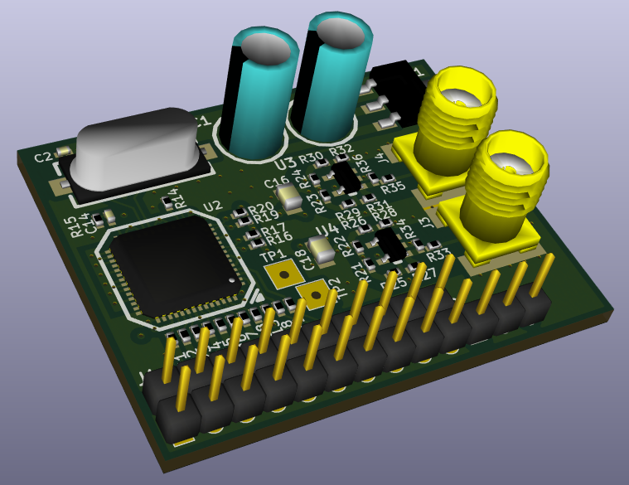
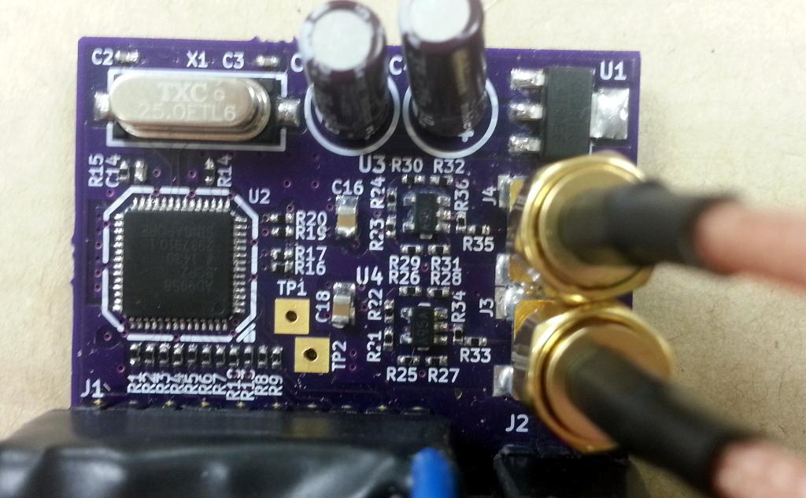
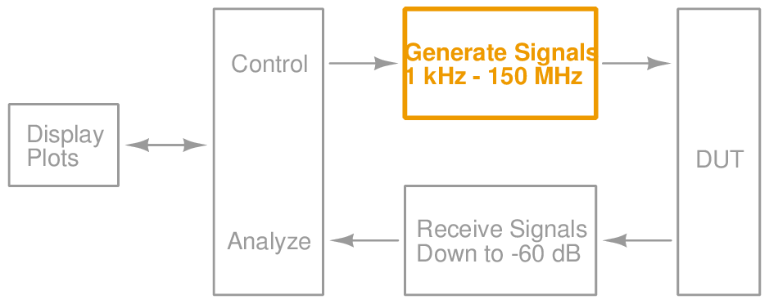
Design — Signal Generation

Slide 8
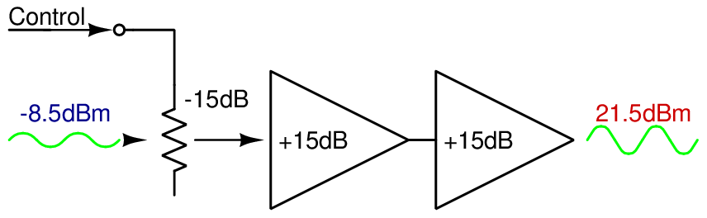
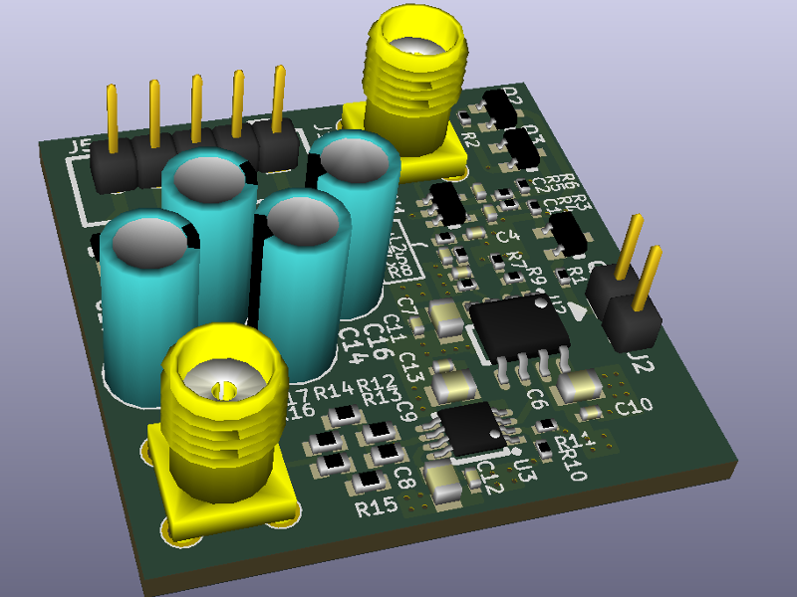
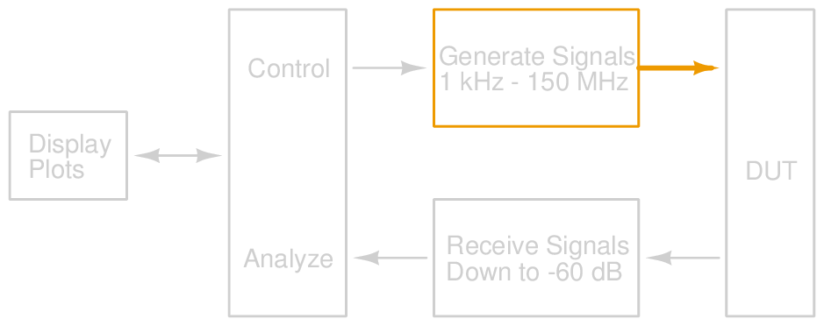
Design — Signal Output

Slide 9
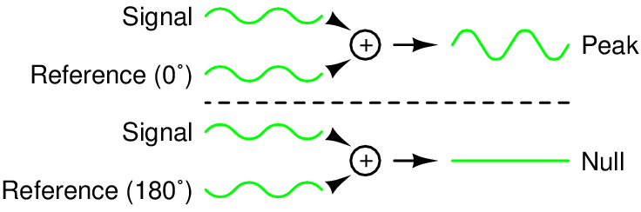
Design — Phase Detection

Slide 10
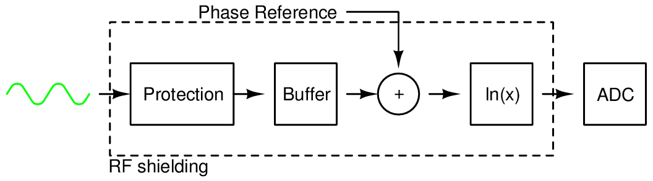
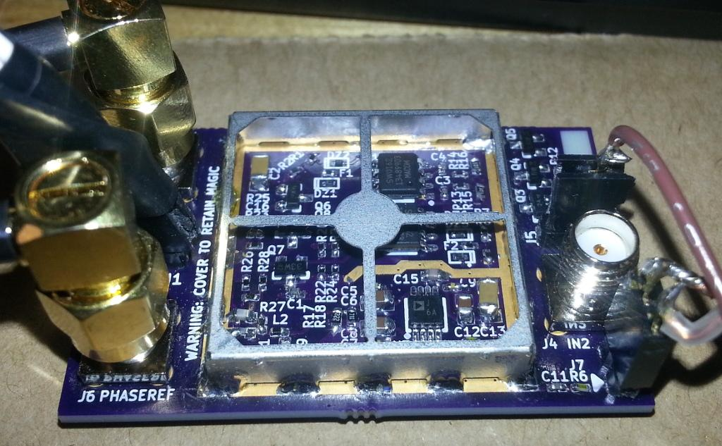
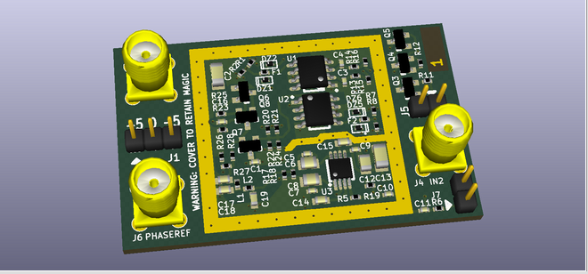
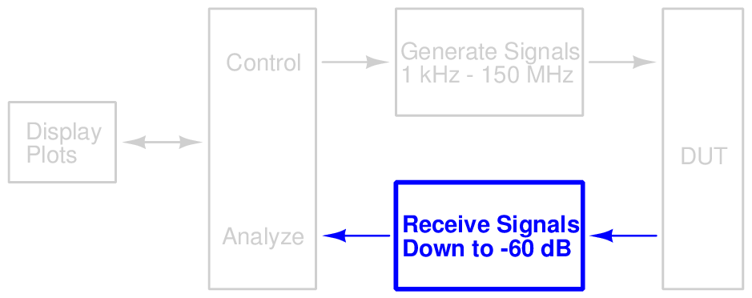
Design — Detection

Slide 11
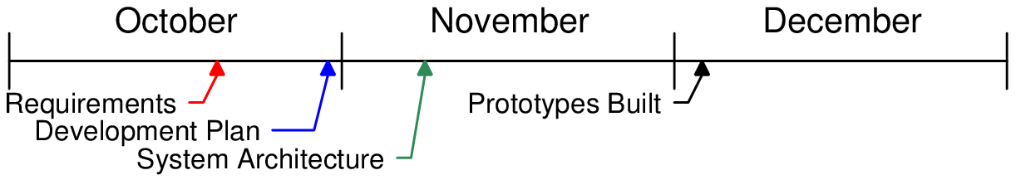
Timeline

Slide 12
Schedule
Item | Start Date | End Date | Percent Complete
PRS | 2014-10-03 | 2014-10-17 | 100%
PDP | 2014-10-17 | 2014-10-31 | 100%
Architecture | 2014-10-31 | 2014-11-14 | 100%
Interim Report | 2014-11-14 | 2014-12-05 | 100%
Proto. built | 2014-11-14 | 2014-12-05 | 100%
Proto. firmware | 2014-11-10 | 2014-12-05 | 100%

Slide 13
Budget
Item | Expended | Actual | Estimated to Completion | Estimated at Completion
Synthesizer | $60 | $60 | $0 | $60
Input | $70 | $70 | $0 | $70
Output amp. | $66 | $66 | $0 | $66
Power supply | $0 | $0 | $0 | $0
Final build | $0 |  | $120 | $120
Enclosure | $0 |  | $30 | $30
Misc/re-spins | $0 |  | $100 | $100
Total | $196 | $196 | $250 | $446

Slide 14
Next Steps
Hardware
Combine prototypes into a final product
Software
Finish firmware with full analysis capability
Write PC software that receives and plots data

Slide 15
Conclusion
Product can capture Bode plots
Uses signal synthesizer, output amplifier, input frontend, ADC, and microcontroller
These have been prototyped and tested

Slide 16
Demo

Slide 17
Questions?

